Slide 1
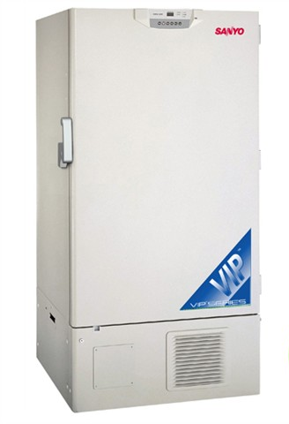
Ultra-Low Freezer Rebate Program Report Fiscal Year 2011-2012

Slide 2
Overview NC State, a world-class research university, has laboratories located across campus that have ultra-low temperature (ULT) freezers. These freezer reach a low temperature of -80°C, or -123°F. ULT freezers 15 years old, or older, use on average 28 kWh to 35 kWh per day; as much energy as an average single-family home uses in a day. These ULT freezers are some of the largest energy consumers found in labs. Recent technology has improved reliability and operation of ULT freezers. This technology reduces today’s ULT freezer energy consumption by as much as half. Energy Management launched the ULT Freezer Rebate Program in November 2011. The rebate program was geared toward upgrading the University’s climate-controlled laboratory storage. The program provided cost-share funding to researchers so old, inefficient, ULT freezers could be replaced with new, energy-efficient, equipment.

Slide 3
Program Goals:
Lower energy consumption
Upgrade ULT freezers to energy-efficient equipment
Decommissioning and recycling old ULT freezers
A Win-Win Program:
50% of the cost of a new ULT freezer was provided to departments
Energy-efficient ULT freezers installed in laboratories
Electric energy consumption was reduced by half using ULT freezers

Slide 4
ULT Freezer Rebate Program NC State identified more than 230 ULT freezers eligible to participate in the rebate program. The program provided 50% of the total replacement cost of the new ULT freezer. Requirements, terms, and conditions of the program: Eligibility Requirements ULT Freezers to be upgraded must be at least 15 years old or older. Terms and Conditions 1. New ULT Freezers must use no more than 18 kWh per day. 2. Rebates are available on a first come, first serve basis, until all funds are exhausted, 3. Old ULT freezers must be properly decommissioned and recycled for scrap metal. 4. ULT Freezer must be purchased within the fiscal year

Slide 5
Key Highlights for FY 2011-12
Six (6) ULT freezers were identified
Six (6) ULT freezers were decommissioned
Six (6) ULT freezers were procured
$57,769 was expended to replace 6 ULT freezers
$32,298 from Energy Management was contributed
32,850 kWh per year in electric energy consumption was avoided
22.7 metric tons, per year, of greenhouse gas emissions were avoided

Slide 6
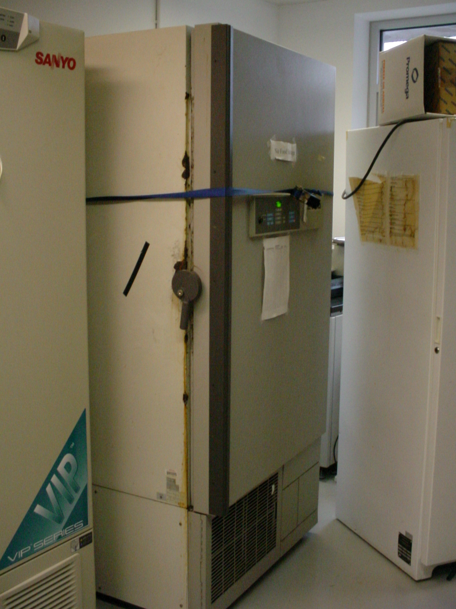
The goal of the rebate program’s goal was to renew NC State’s ULT freezer inventory from old energy-inefficient equipment to new energy-efficient unit.
Old ULT Freezer
New Energy-Efficient ULT Freezer

Slide 7
Outreach
Energy Management and NC State Sustainability Office developed an outreach flyer (on the right) to launch the program to the campus research community.
A blast e-mail was sent to building liaisons and department heads.
Flyers were posted on billboards, on NC State Sustainability’s website, and on Energy Management’s website.
Face-to-face contact between Energy Management and lab research custodians promoted the ULT freezer rebate program.

Slide 8
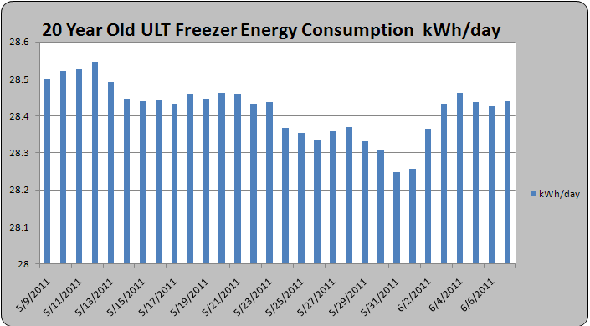
Energy Consumption
Energy Management monitored energy consumption of an 18 cubic foot (cf) freezer located on the Centennial Campus’s Toxicology building. On average, the freezer consumed 28 kWh per day. When compared to a new unit of similar size and storage capacity, the new unit consumed, on average, 15 kWh per day; 45% less energy than the older ULT freezer.
Figure-1, Electrical Energy Consumption of a 20 Year Old Freezer .

Slide 9
Summary The average daily electrical energy consumption of a new 18 cubic foot (cf) ULT freezer is 15 kWh, and 19 kWh for a 25 cf freezer. Energy Management replaced two (2) 18 cf ULT freezers and four (4) 25 cf ULT freezers. The annual electric energy consumption avoided by replacing these six (6) units will be 32,850 kWh. Greenhouse gas emissions (GHG) will be reduced by 22.7 metric ton of CO_{2.} Due to the success of this first phase of the ULT Freezer Rebate Program, Energy Management will help initiate future freezer replacement programs on NC State’s campus. The lessons learned from phase one (1) will ensure continuation of this program and help develop additional rebate and equipment modernization programs.

Slide 10
Lesson Learned
Future programs need to roll out sooner in the fiscal year cycle when scientists and researcher have available funding.
When Energy Management launched the rebate program in the latter part of the fiscal year, scientist and researchers did not have sufficient funding readily available to take advantage of the program.
In order for Energy Management to be able to target labs that have old ULT freezers, the CAM’s inventory database needs to be current.
Encourage researchers to update the database as soon as an ULT freezer is decommissioned or a new one is procured.
Facilitate quicker processing of reimbursing claims by directly applying the 50% the invoice in lieu of giving the funds to the department.
This will expedite the time needed by Business Services to process the reimbursement claims.
Advertise the Freezer Rebate Program directly to the owners of old ULT freezers to increase the success of the program.

Slide 11
Next Steps Energy Management will continue to advocate the push to upgrade the University’s ULT freezer inventory. Twenty additional ULT freezers procured from 1981 to 1997 are eligible to be upgraded under the program. Energy Management is planning to upgrade these freezers at the next funding opportunity. Energy Management will monitor one of the new energy efficient ULT freezers to ensure the proper measurement and verification of the rated energy savings. Energy Management is also looking at other ULT freezer operation strategies to further reduce the ULT freezer’s electric energy consumption. One of the strategies is to raise the ULT freezer’s operating temperature from -80°C to -70°C. Documentation from the University of Colorado Boulder shows that this strategy further reduces the electric energy consumption of an ULT freezer by 2 kWh/day without affecting stored samples.

Slide 12
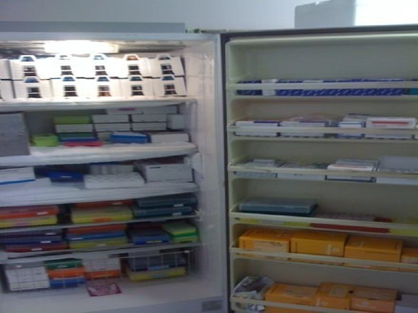
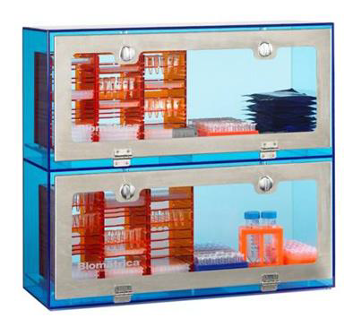
In addition to the ULT Freezer Rebate Program, Energy Management is looking for other ways to store samples more economically. One example is to store DNA and RNA samples at room temperature. Room Temperature storage is the ability to store samples at room temperature (i.e., ~ 72°F). Scientists and researchers can store their samples at room temperature with the peace of mind that samples will not be destroyed during brown-outs or black-outs.

Slide 13
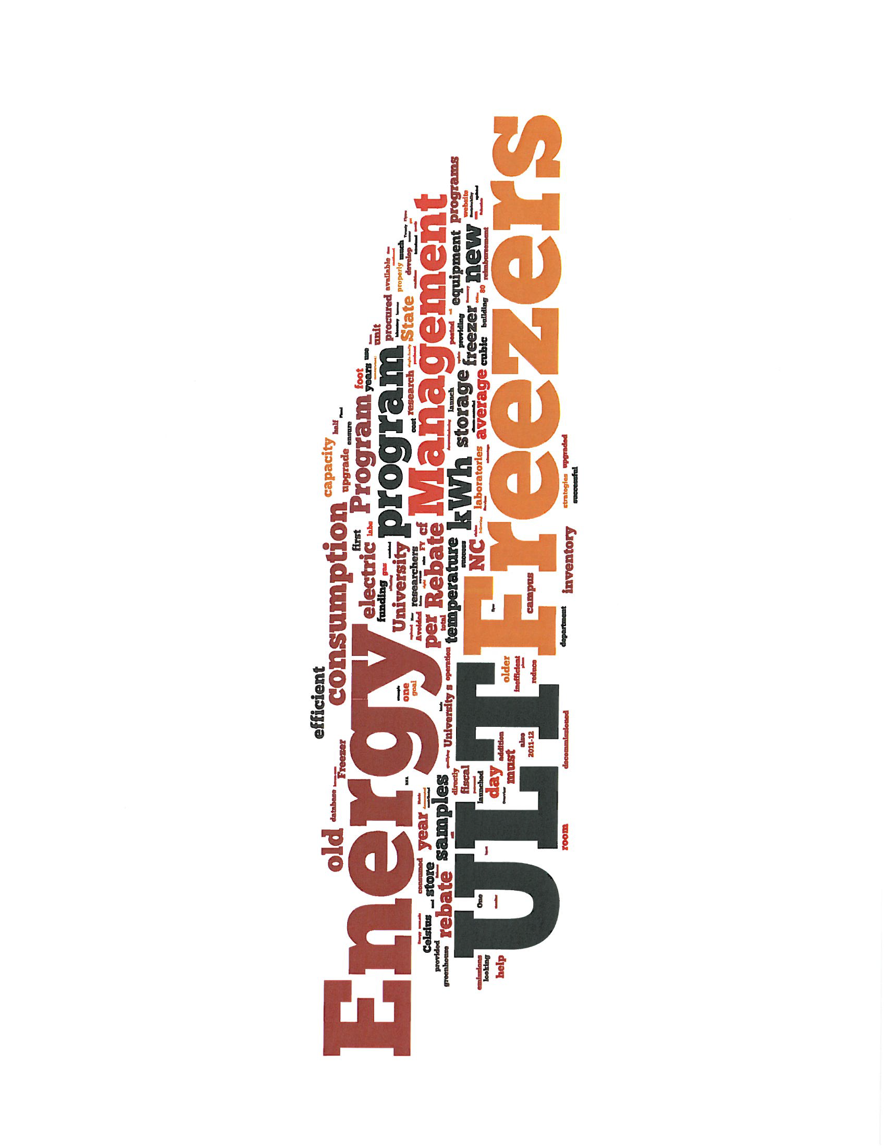
Prepared by:
NC State University Energy Management
Save_energy@ncsu.edu
June 2012

