Slide 1
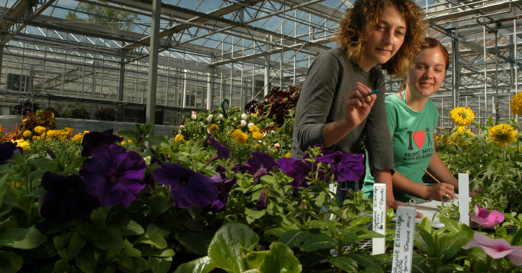
CEST - OUTREACH WG

Slide 2
AGENDA
Introductions - 2 min.
History/Where we Are – 15 min.
Plan Brainstorm Session – 10 min.
Energy Campaign Introduction – 10 min.
Key Messages Brainstorm – 15 min.
Regroup and Share – 20 min.
Something to chew on – 10 min.

Slide 3
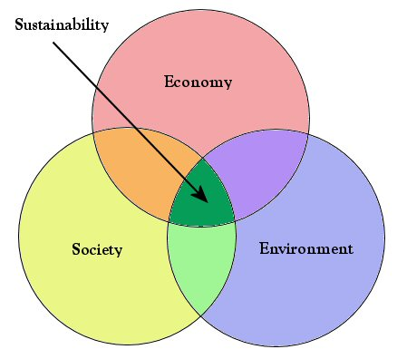
SUSTAINABILITY IS ABOUT BALANCE
Triple bottom line:
People matter
Economy matters
Environment matters
www.ncsu.edu/sustainability

Slide 4
SUSTAINABLE DREAM WORLD
Renewable energy
Strong workforce
Clean water
Balanced population
Economically diverse
Mobility
Wise water use
Healthy citizens
Stable society
Clean air
Safe communities
Zero waste
Community participation
Energy efficient
Educated citizens
Livable wages & prosperity

Slide 5
HISTORY
CEST Administrative Advisory Council, Summer ‘09
2 co-chairs
7 other WGs
Work started on CAP in Aug. ‘09
AEI as consultants to CAP process

Slide 6
WHERE WE ARE NOW
AEI has reached first deliverable of CAP
Priorities to be developed by CEST in July
Energy Charge – Due 9/17
Sustainability Strategic Plan – Due 9/17
Energy Awareness Campaign – Oct. launch

Slide 7
CHARGES of GROUP
Need Master Plan Name - 7/15
Name of Energy Campaign - today
Energy Campaign Key Messages – 7/15
Master Plan Strategies - Aug. 9th
Master Plan Tactics - Sept. 2nd

Slide 8
ENERGY CAMPAIGN OVERVIEW
Target Audience(s): incoming freshman, on campus residents, Greeks & staff
Building energy competitions
Shut the Sash – fume hoods
Enhance existing and establish new traditions
Mixed media use
Community-based social marketing = behavior change
Goal: 5% reduction

Slide 9
CAMPAIGN NAMES
LIGHTS OUT
CHANGE YOUR STATE
DO IT IN THE DARK
DO ONE THING

Slide 10
KEY MESSAGES
Questions to consider:
What is in it for me?
Saving energy and acting sustainably will cost me more and take more time out of my day.
My tiny action has no impact on climate change.
How does it impact the university?

Slide 11
CONTACT INFORMATION
Tracy Dixon, Director 513-0211
Lindsay Batchelor, Program Coordinator 513-3337
David Dean, Outreach & Comm Coordinator 513-0177
sustainability.ncsu.edu
www.facebook.com/ncstatesustainability

