Slide 1

AGENDA
July 21 – 10am – 11am
Review survey & agree on plan name
Review key messages – anymore feedback?
What are all these acronyms?
Strategies vs. Tactics
Group Work: Brainstorm Strategies
Homework: Develop your own strategy

Slide 2
Change Your State
Key Messages:
‘Do One Thing’
‘Don’t be a drip’
‘Little changes, big impact’
‘Break for transit/transportation’
‘Make IT green’
‘Reduce Your Paw Print’
‘Make a Climate Connection: Reduce Your Paw Print’

Slide 3
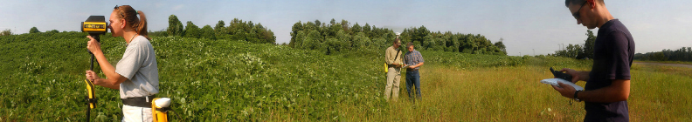
WHAT IS SUSTAINABILITY?
“……development meets the needs of the present without compromising the ability of future generations to meet their own needs.”
      - Our Common Future/Brundtland Report, UNWCED

Slide 4

AMERICAN COLLEGE AND UNIVERSITY PRESIDENTS CLIMATE COMMITMENT
Addresses global warming through a commitment to work towards climate neutrality
Co-organized by AASHE, ecoAmerica and Second Nature: www.aashe.org
Over 650 signatories nation-wide
NC State signed the ACUPCC in 2008

Slide 5
REQUIREMENTS OF THE ACUPCC
Within two months of signing this document, create institutional structures to guide the development and implementation of the plan NC State action = CEST
Within one year complete a comprehensive inventory of greenhouse gas (GHG) emissions and update the inventory every other year thereafter NC State action = 2008 GHG Report
Within two years of signing this document, develop an institutional action plan for becoming climate neutral NC State action = In Process
Initiate two or more tangible actions to reduce greenhouse gases while the more comprehensive plan is being developed
NC State action = next slide
Make the action plan, inventory, and periodic progress reports publicly available NC State action = CEST web site
Source- http://www.presidentsclimatecommitment.org/html/commitment.php

Slide 6


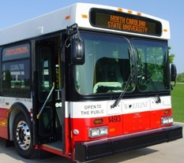
TANGIBLE ACTIONS at NC STATE
U.S Green Building Council’s LEED Silver Standard or equivalent
U.S. EPA’s ENERGY STAR Partner
Provide access to public transportation

Slide 7

GREENHOUSE GAS INVENTORY?
For the purposes of the ACUPCC, a GHG inventory quantifies your campus “carbon footprint” in terms of metric tons of carbon dioxide equivalent per year (MTeCO2/yr)

Slide 8




GREENHOUSE GAS INVENTORY
WHO: Jeff Hightower- Director of Utilities Infrastructure for Facilities Operations and student interns
WHEN: Time Frame- Data from both 2008 calendar year and 2007/2008 Fiscal Year
WHERE: Boundaries- Main Campus, Centennial Campus, Centennial Biomedical Campus and some satellite offices
HOW: Calculators- Clean Air, Cool Planet; Climate Registry; EPA; Atmosfair
Notes:
15 million square feet
40,000 faculty, staff, students – 17th largest city in NC

Slide 9
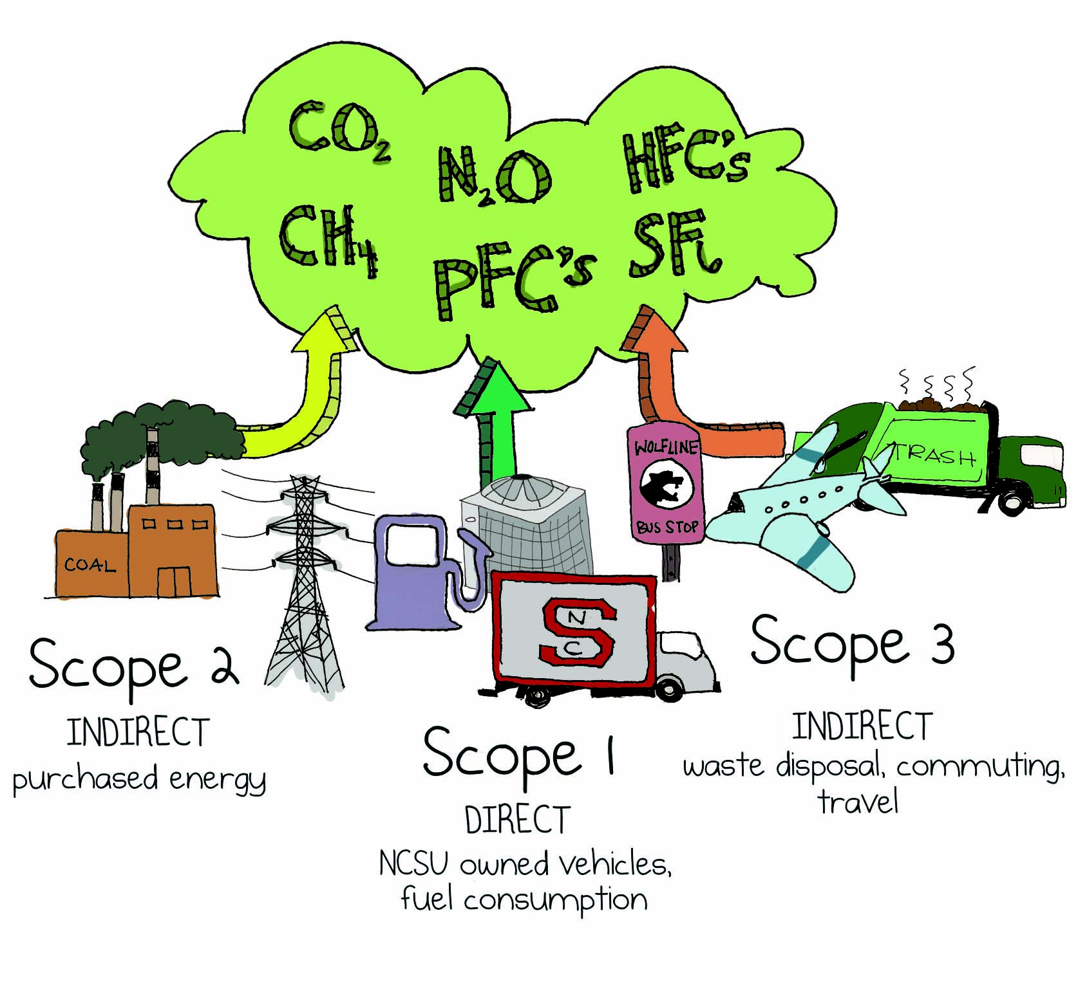
GHG INVENTORY - SCOPES

Slide 10
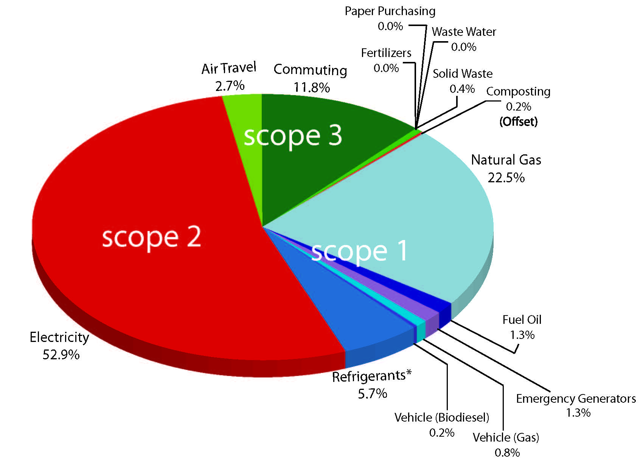
2008 GHG INVENTORY
Notes:
Roughly 285,000 MTCO2e

Slide 11
GHG LEGISLATION
The State of NC has proposed Title V Permit holders with point sources to submit their GHG emissions for Calendar Year 2009 daq.state.nc.us/monitor/eminv/gcc/ghg_emis_rep.shtml
Senate Bill 668 – 20% reduction of energy by 2010 and 30% reduction of energy by 2015
There are currently a number of proposed bills in the United States Congress that address GHG emissions

Slide 12
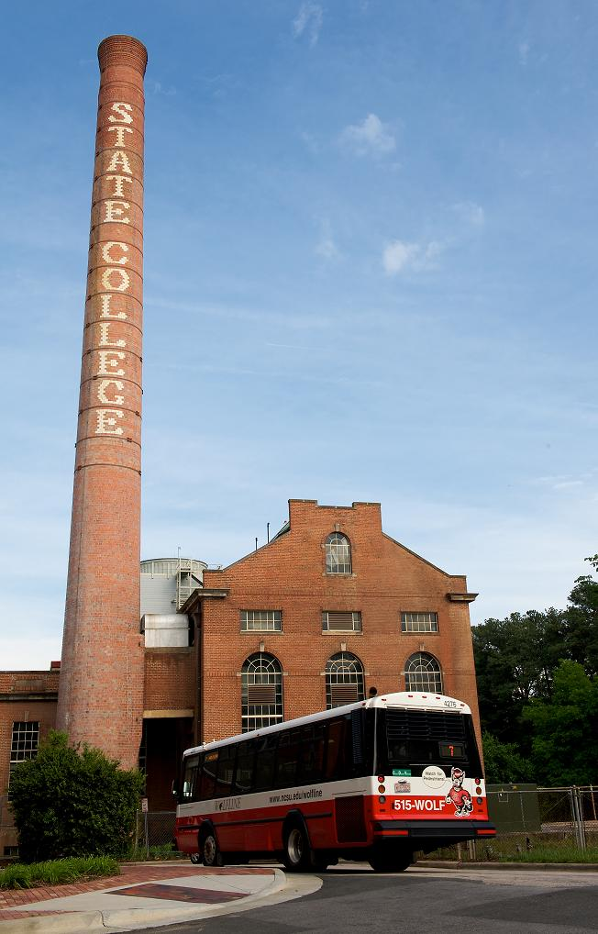
WHAT IS A CLIMATE ACTION PLAN?
A comprehensive plan including a target date and interim milestones for how NC State will reach climate neutrality
Will include the following sections:
  Introduction
  Campus Emissions
  Mitigation Strategies
  Educational, Research and Community Outreach Efforts
  Financing
  Tracking Progress

Slide 13
CARBON MANAGEMENT HIERARCHY
Avoid carbon-intensive activities (and rethink business strategy)
Avoid
Reduce
Do whatever you do more efficiently
Replace
Replace high-carbon energy sources with low-carbon energy ones
Offset
Offset those emissions that cannot be eliminated by the above
Modified Version from “Getting to Zero: Defining Corporate Carbon Neutrality” by Clean Air – Cool Planet

Slide 14
CAMPUS ENVIRONMENTAL SUSTAINABILITY TEAM (CEST)
Administrative Advisory Council (appointed)
8 Working Groups (anyone can join)
Campus Sustainability Program
Sustainability Strategic Plan
Climate Action Plan & Tactical Plan
Increased focus on energy
Accountability
www.ncsu.edu/sustainability/cest.php

Slide 15



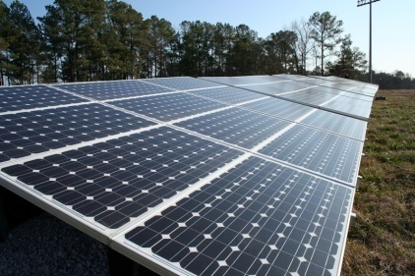
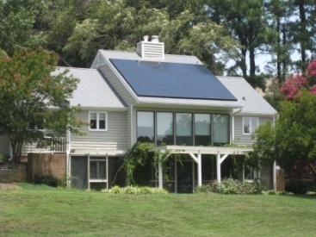
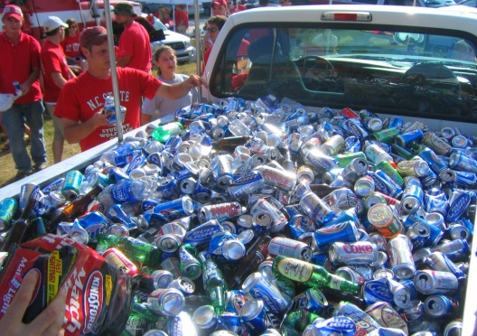

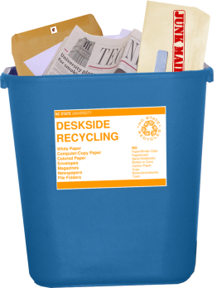

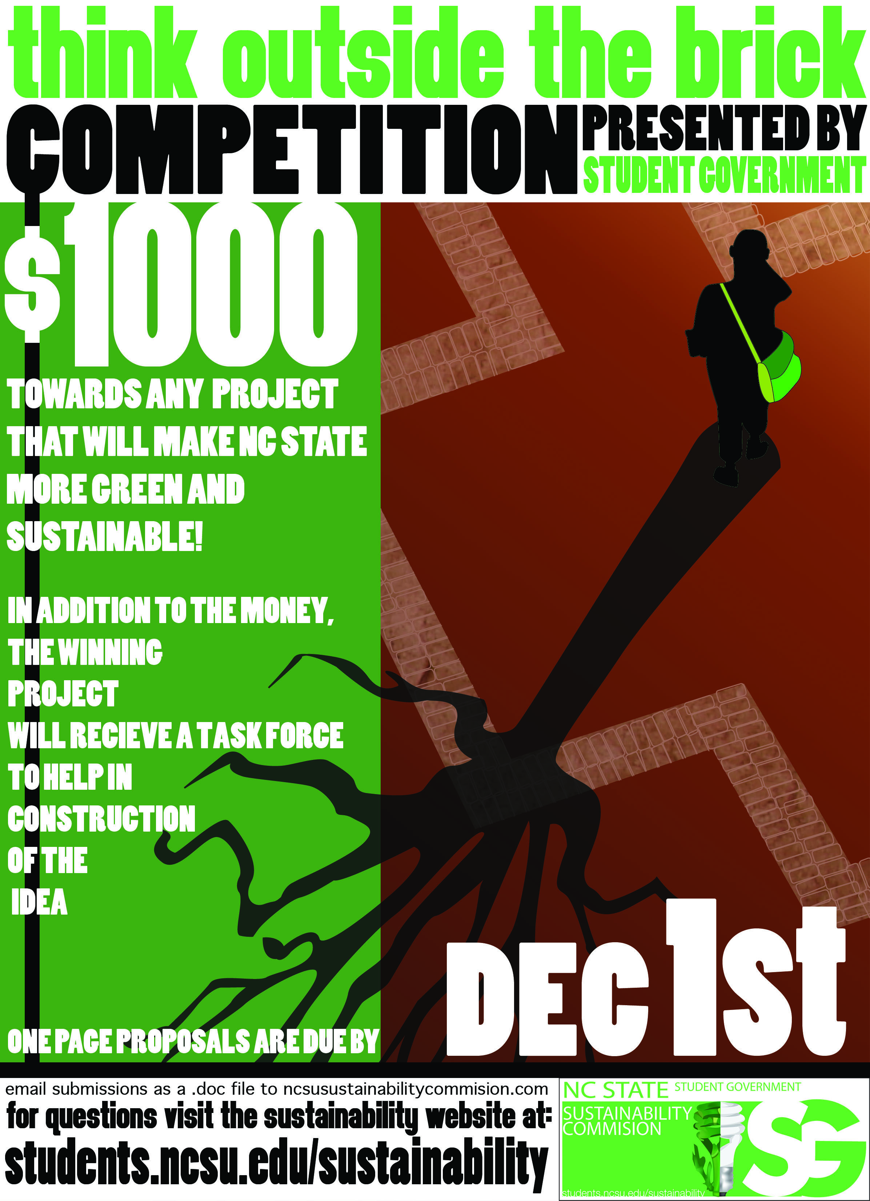



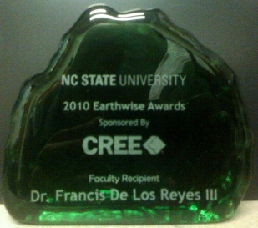
ESTABLISHED PROGRAMS
Earth Day
www.ncsu.edu/earthday

Slide 16
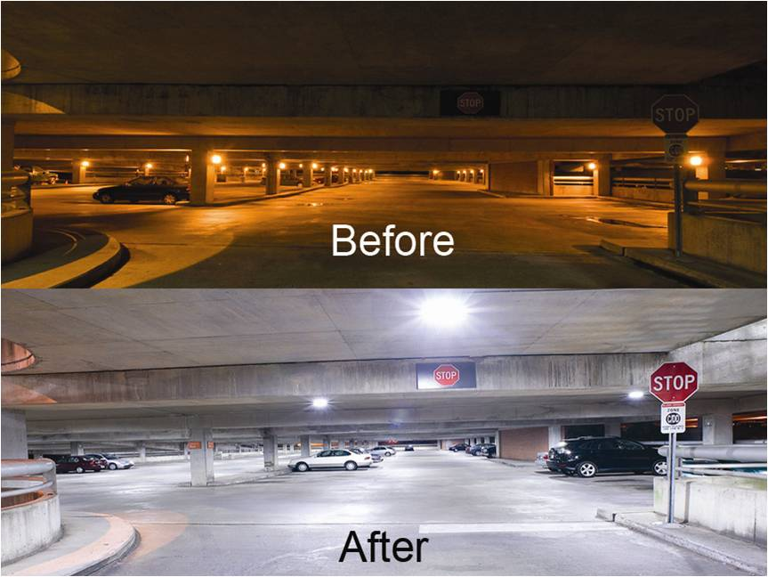
EXAMPLE PROJECTS
13 building energy performance contract projected to save $33 million in energy costs over 20 years through efficiency upgrades
Combined heat and power project projected to reduce greenhouse gas emissions by 12-15% and save $12 -15 million on energy
LED lighting in Bragaw Residence Hall saw a 66% reduction in electrical consumption for lighting

Slide 17
PARTNERS NEEDED TO ADVANCE
NC State is the example of sustainability
Awareness
Individual programs
Campus culture - shared responsibility & people taking action across mission areas
NC State is an environmentally, socially, & economically balanced university
Meredith, Peace, St. Augustine’s
NC State, UNC-CH, Duke

Slide 18
STRATEGIES vs. TACTICS
Strategies = the big picture
Tactics = how we will accomplish strategies
Example:
Make campus-wide sustainability efforts and progress more visible
Create a coordinated local media campaign to share NC State success stories
Integrate sustainability into NC State branding and advancement campaigns
Standardize sustainability messaging across departments, administration and colleges

Slide 19
OUTREACH STRATEGIES of OTHER WGs
Begin establishing a campus culture that embraces personal responsibility and emphasizes action in creating a sustainable campus and community
Create a communications and marketing plan that sends a cohesive, campus wide message regarding sustainability
Further develop sustainability-related event traditions such as Earth Day and Campus Sustainability Day
Maintain regular informal and formal networking and educational opportunities
Develop campus wide recognition mechanisms for participating in sustainable behavior
Encourage the matching of student and faculty member projects to NC State’s physical campus and establishing roles for volunteers
Develop a procedure for integrating sustainability teaching, research and extension expertise into physical campus projects

Slide 20

REFERENCE INFO
www.ncsu.edu/sustainability
www.ncsu.edu/sustainability/cest/cest_meetings.php
www.facebook.com/ncstatesustainability
www.twitter.com/ncstatesustain

