Slide 1
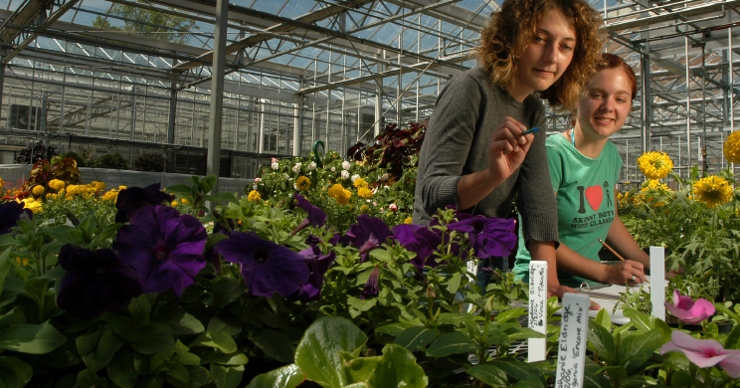
CEST - OUTREACH WG – July 15, 2010

Slide 2
CHEW ON THIS – Paul McConocha
Key Phrase: Make a Climate Connection, Reduce your Carbon Pawprint
Who is the audience? Campus residents and staff
What do you hope to accomplish? Think globally, act locally to…Slow down climate change.
Where will you spread the word? Internally mostly.
(internal/external communications)
When will you deliver the message? All the time.
(time of day, time of year, etc.)
Why participate? It’s the right thing to do, and it resonates w/ students.
How will you spread the word? Replace “Just Switch It” building decals.
(tools, materials, media outlets, etc.)

Slide 3
CHEW ON THIS – Tracey Peake
Key Phrase: ): "Don't be a drip"; "Don't let your future go down the drain" - although honestly I'm wondering if there's a way to phrase this that is shorter and that avoids the "don't" at the beginning ... creative people, help! I'm just a science writer...
Who is the audience? Primarily students, but also faculty/staff.
What do you hope to accomplish? 5% water usage reduction over the school year, maybe a slightly higher percentage during the 6 week focus...
Where will you spread the word? Pick a 6-week period in Fall/Spring. May be better to do it in summer/early fall, when we tend to be dry and drought is a factor that will help raise awareness.
Why participate? It would be nice to offer small incentives to winners of challenge - maybe pizza/ice cream party or little tchotchkes if budget allows. But if not we can focus on the participation makes you feel good,helps environment.
How will you spread the word? Wolfbytes, Student Radio, bus signage, res/ hall/building signage, Technician coverage, Twitter/Facebook pages (especially if we did a 5-minute shower challenge where buildings compete to reduce water usage), Bulletin story (for faculty/staff) possible local media pitches with results of challenge: we did something like this with UNC-CH during the drought, it's a cutesy story for a slow news day, particularly if the weather stays dry...

Slide 4
UPDATE
All other ‘Chew on This’ reports are captured in the meeting minutes
Please make sure to take the survey for the document name as it has been revised
Please take the key messages survey to list your top 3

