Slide 1
MEETING AGENDA 1-20-10
Welcome and Introductions- Working Group Chair
Where We Are/Where We Are Going- Lindsay Batchelor
GHG Inventory and CAP Overview- Lindsay Batchelor/Jeff Hightower
Approach and Goals of the CAP Project- John Carter, AEI
GHG Impact for Focus Area- John Carter, AEI
List Development- All
Next Steps- Lindsay

Slide 2
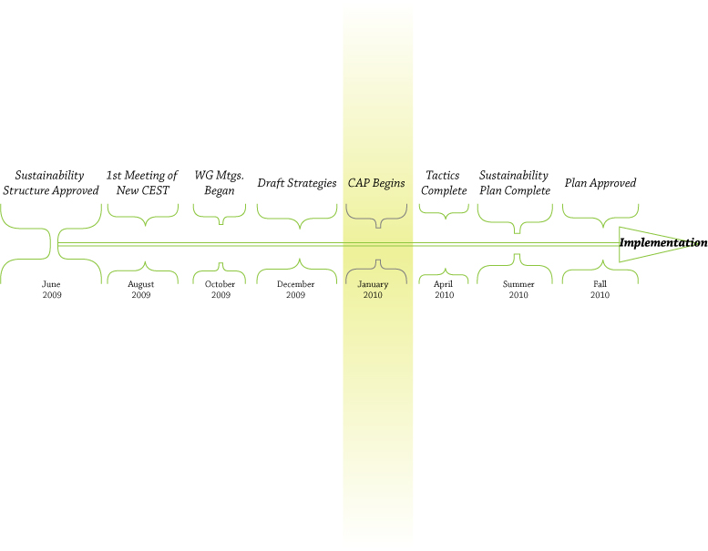
UPDATE ON PLANNING PROGRESS

Slide 3
TIMELINE
January 19-21: CAP Long list development begins (AEI and Energy Strategies onsite)
January 22 – February 10: Continue long list development and evaluation (WG meeting needed)
February 11 – March 10: Finalize long list (WG meeting needed)
March 10- April 30: Development of tactics for SSP
March 24: Consultant presents long list to CEST

Slide 4
TIMELINE cont’d
March 24 – April 22: Sustainability Office vets long list on campus
April 30th- Tactics due to Sustainability Office
April 23 – May 12: Consultant develops short list
Summer: Sustainability Office to merge SSP and CAP

Slide 5
SUSTAINABILITY STRATEGIC PLAN
Climate Action Plan
Energy & Water
Land Use
Buildings
Materials & Purchasing
Academics & Research
Transportation
Waste Reduction & Recycling

Slide 6
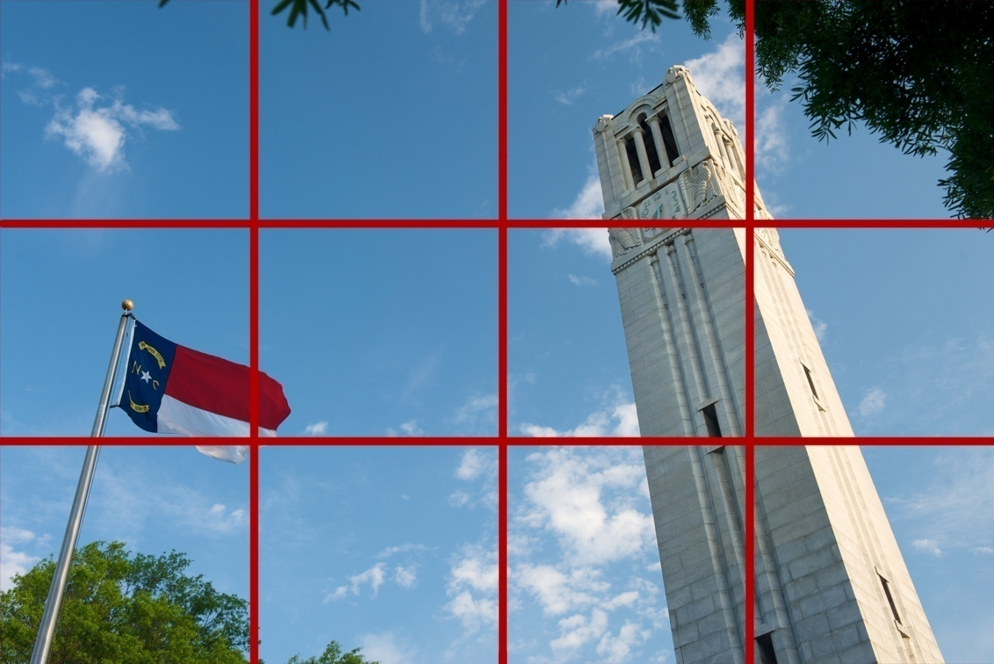
CLIMATE IMPACT AT
NC STATE UNIVERSITY

Slide 7

AMERICAN COLLEGE AND UNIVERSITY PRESIDENTS CLIMATE COMMITMENT
Addresses global warming through a commitment to work towards climate neutrality
Co-organized by AASHE, ecoAmerica and Second Nature
Over 650 signatories nation-wide
NC State signed the ACUPCC in 2008

Slide 8
REQUIREMENTS OF THE ACUPCC
Within two months of signing this document, create institutional structures to guide the development and implementation of the plan
Within one year complete a comprehensive inventory of greenhouse gas (GHG) emissions and update the inventory every other year thereafter
Within two years of signing this document, develop an institutional action plan for becoming climate neutral
Initiate two or more tangible actions to reduce greenhouse gases while the more comprehensive plan is being developed
Make the action plan, inventory, and periodic progress reports publicly available
Source- http://www.presidentsclimatecommitment.org/html/commitment.php

Slide 9


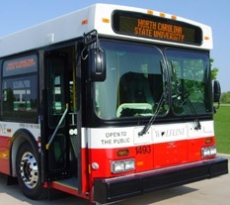
NC STATE UNIVERSITY’S TANGIBLE ACTIONS
U.S Green Building Council’s LEED Silver Standard or equivalent
U.S. EPA’s ENERGY STAR Partner
Provide access to public transportation

Slide 10

WHAT IS A GHG EMISSIONS INVENTORY?
For the purposes of the ACUPCC, a GHG inventory quantifies your campus “carbon footprint” in terms of metric tons of carbon dioxide equivalent per year (MTeCO2/yr)

Slide 11




NC STATE GHG EMISSIONS INVENTORY
WHO: Jeff Hightower- Director of Utilities Infrastructure for Facilities Operations and student interns
WHEN: Time Frame- Data from both 2008 calendar year and 2007/2008 Fiscal Year
WHERE: Boundaries- Main Campus, Centennial Campus, Centennial Biomedical Campus and some satellite offices
HOW: Calculators- Clean Air, Cool Planet; Climate Registry; EPA; Atmosfair

Slide 12
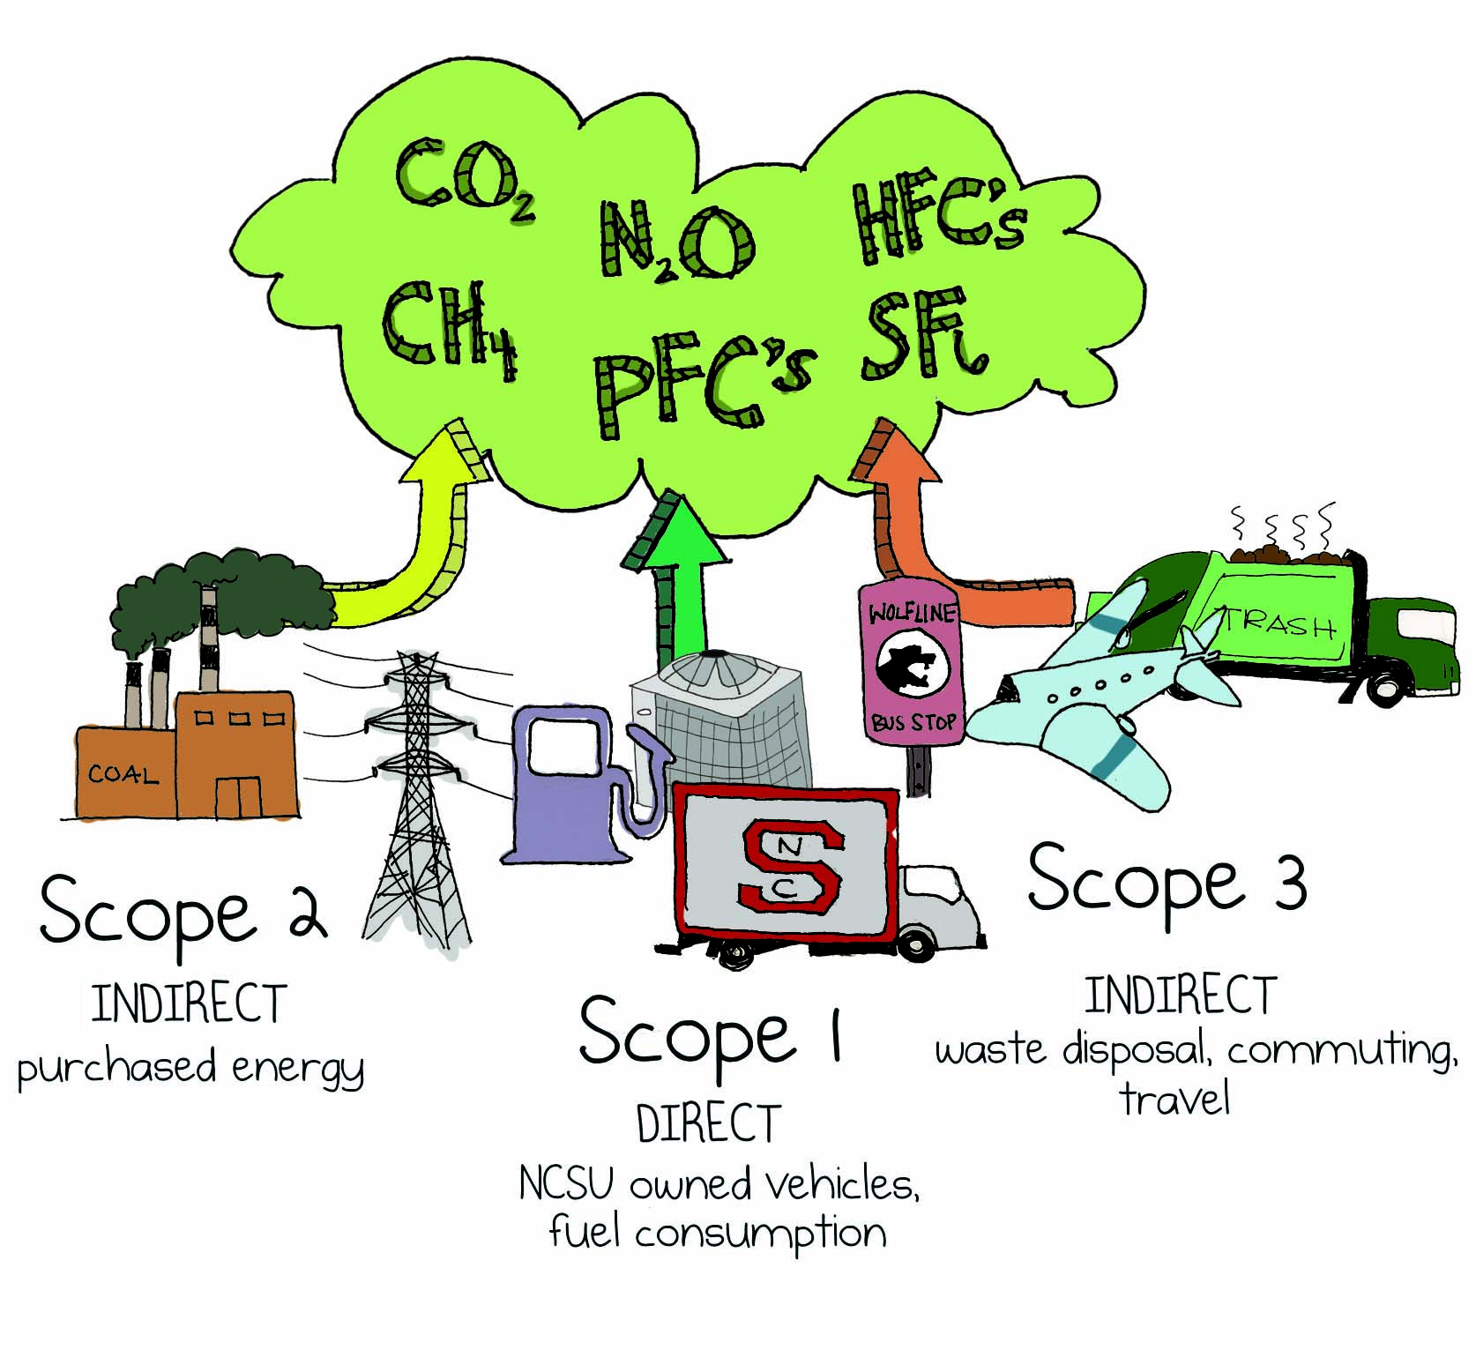
GHG EMISSIONS INVENTORY- SCOPES

Slide 13
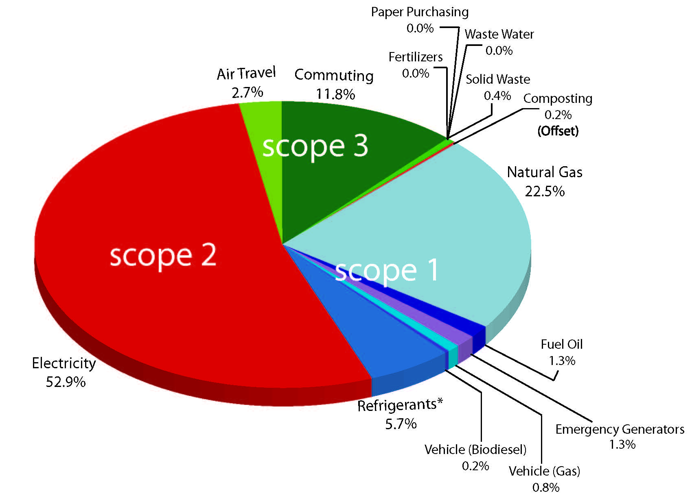
GHG EMISSIONS INVENTORY- 2008

Slide 14
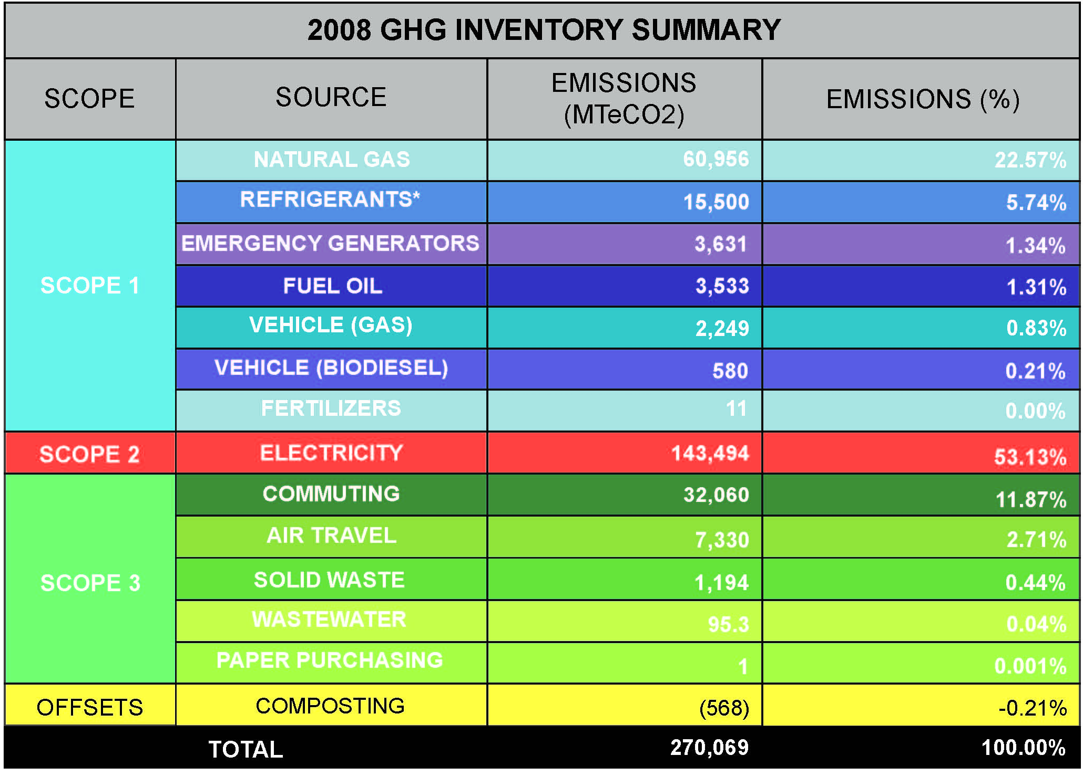

Slide 15
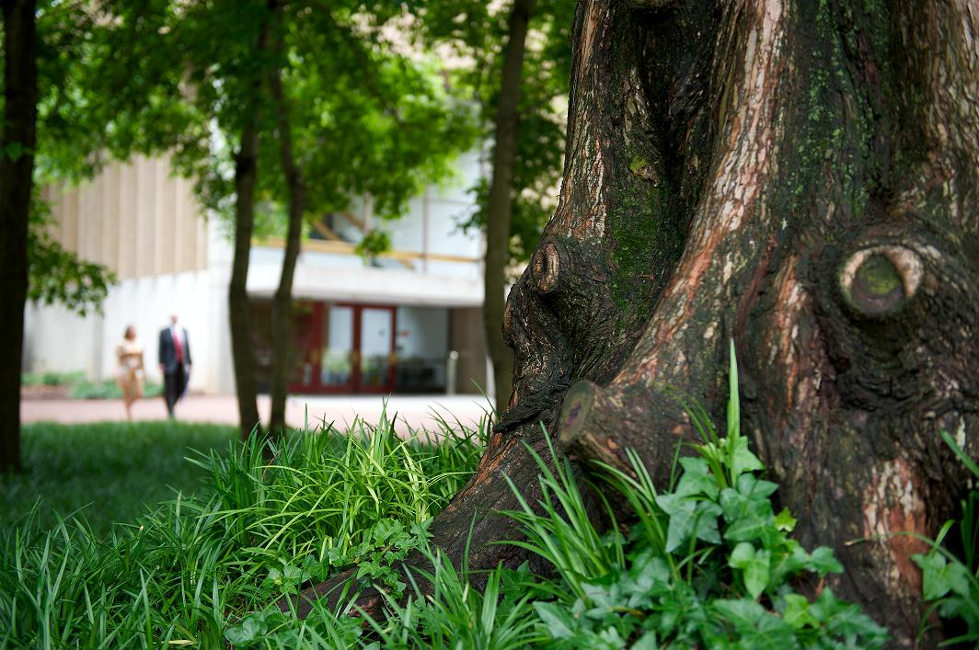
CLIMATE ACTION PLANNING

Slide 16
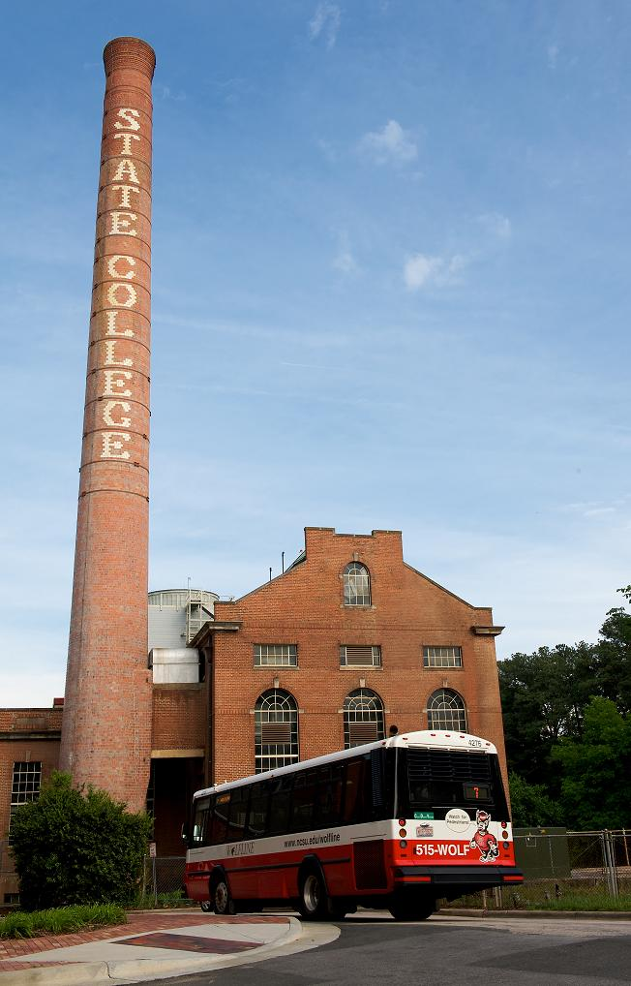
WHAT IS A CLIMATE ACTION PLAN?
A comprehensive plan including a target date and interim milestones for how NC State will reach climate neutrality
Will include the following sections:
  Introduction
  Campus Emissions
  Mitigation Strategies
  Educational, Research and Community Outreach Efforts
  Financing
  Tracking Progress

Slide 17
THE CARBON MANAGEMENT HIERARCHY
Avoid carbon-intensive activities (and rethink business strategy)
Avoid
Reduce
Do whatever you do more efficiently
Replace
Replace high-carbon energy sources with low-carbon energy ones
Offset
Offset those emissions that cannot be eliminated by the above
Modified Version from “Getting to Zero: Defining Corporate Carbon Neutrality” by Clean Air – Cool Planet

Slide 18
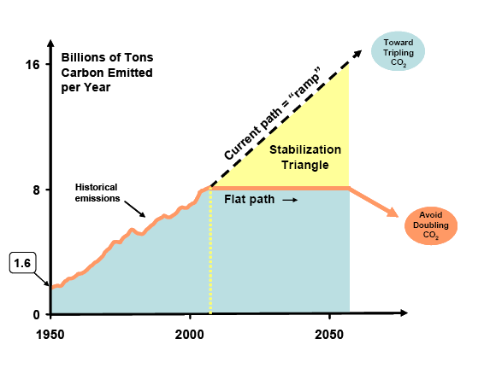
STABILIZATION TRIANGLE (PACALA-SOCOLOW)
Graph from the Princeton Environmental Institute’s “Stabilization Wedges: A Concept and Game”

Slide 19
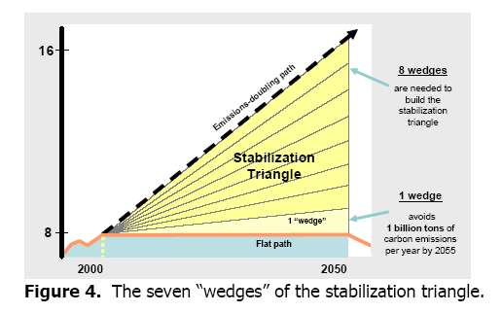
STABILIZATION WEDGES (PACALA-SOCOLOW)
Graph from the Princeton Environmental Institute’s “Stabilization Wedges: A Concept and Game”

Slide 20
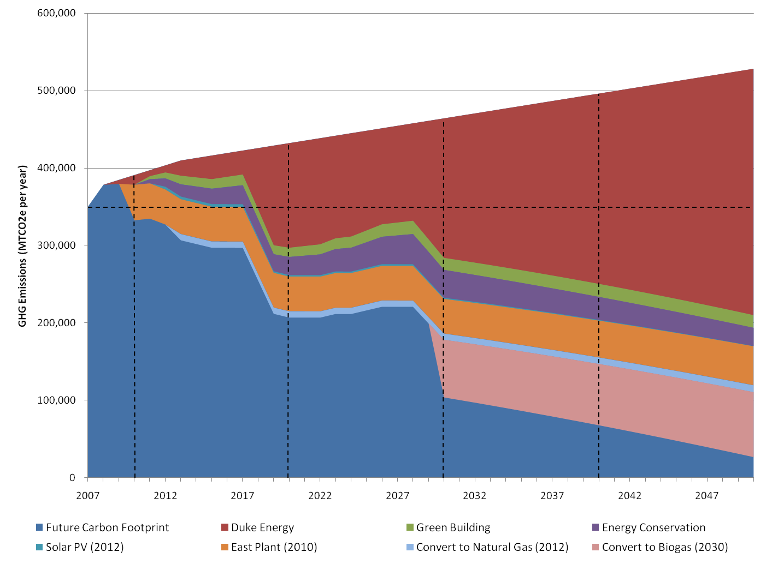
ACTUAL EXAMPLE – DUKE UNIVERSITY

Slide 21
Climate Action Plan
Traditional valuation

Slide 22
Climate Action Plan
Value when GHG has a price

Slide 23
CAP WEDGE GROUPS
  Green Development (campus growth, new buildings)
  Energy Conservation (existing buildings)
  Fuel Mix and Renewable Energy
  Transportation (commuting, business travel, fleet)
  Offsets (off-campus carbon reduction)
  *Base Case
    Define “business as usual” assumptions across all wedges
    Estimate “do-nothing” cost associated with GHG emissions

Slide 24
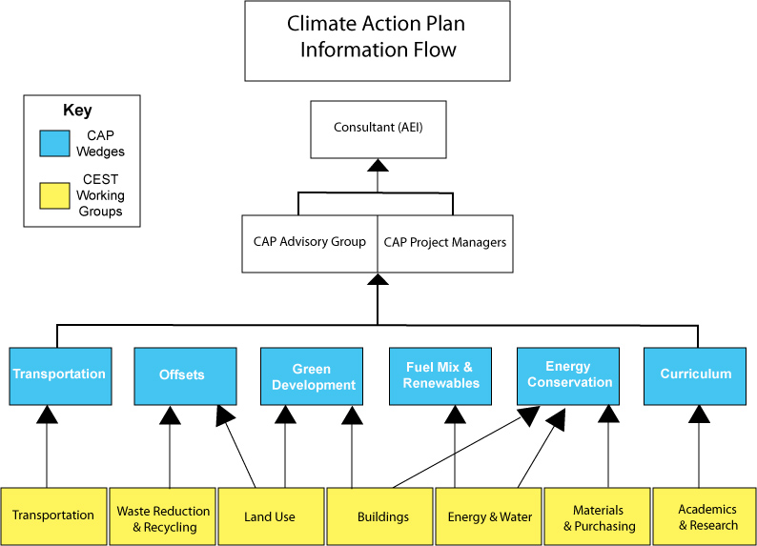

Slide 25
AEI APPROACH
Phase 1
Phase 2

Slide 26
BUILDINGS GHG IMPACT
  Future building design standards (5-10%)
    LEED Silver
    Senate Bill 668
  Space utilization

Slide 27
BUILDINGS STRATEGIES
Apply sustainable practices to all new buildings and renovations, including private buildings
  Undertake holistic building renovations that include conservation of all natural resources in retrofits
  Adopt a sustainability vision statement or include it as part of the scope statement for all projects
  Uphold NC State’s commitment to build LEED silver minimum buildings for all projects over 20,000 gross square feet (strive for higher certification levels)
Account for climate neutrality goals in capital improvement projects
  Minimize building footprints
  Design and construct flexible space that can be repurposed easily

Slide 28
STRATEGIES cont’d
Maximize space utilization (work with Land Use)
  Optimize building usage and operation schedules
Make campus sustainable efforts more visible (likely move to outreach section)
  Market campus sustainable efforts
  Provide outreach to researchers on campus to engage in development of new sustainable measures

Slide 29
NEXT STEPS AND DISCUSSION
Feed any remaining ideas to WG Chairs
Ideas will be compiled and sent out for review
WG Chairs set up upcoming meetings
Comments/Questions?
www.ncsu.edu/sustainability/cap.php

