Slide 1
Transparency in Data Use and Financial Statements:
The Next Step for Sustainability Programs
Bill Winner
May, 2013

Slide 2
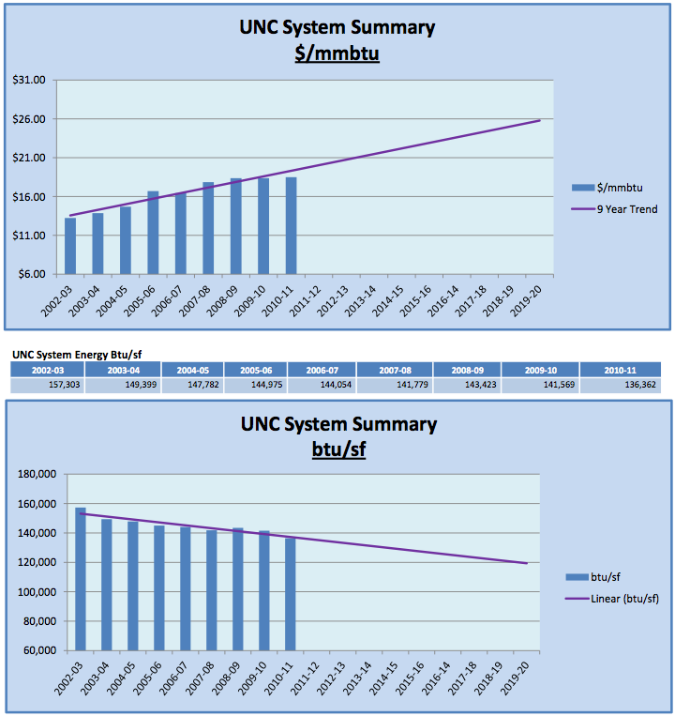
“At current levels,
a 25% reduction in
energy usage
would yield a
20-year savings in
excess of $1 billion.”
Sustainability for the UNC System
http://sustain.appstate.edu/university-data

Slide 3
Consider Statistics:
How to present data?
Histogram bars?
Scattergram?
How to Present
Statistics?
Correlation?
Regression?
Linear?
Curves?
Extrapolation?
How far back?
How far forward?
Sustainability for the UNC System
http://sustain.appstate.edu/university-data

Slide 4
Consider Economic Claims:
What are assumptions?
Energy costs?
Energy conservation?
Energy efficiencies
Economic change?
Inflation?
Innovative technologies?
Savings estimates
Cost savings/avoidance?
Costs of ESCOs?
Costs of Energy Mngmnt?
Sustainability for the UNC System
http://sustain.appstate.edu/university-data

Slide 5
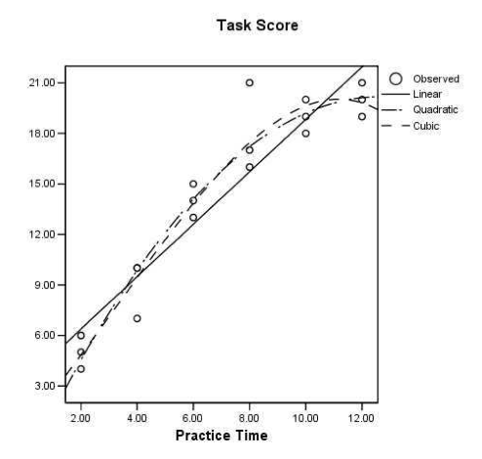
Let’s Talk a Bit
About Data
One data set; Three Regression Curves
How to Extrapolate?
http://jtemplin.coe.uga.edu/files/regression/epsy581s05/epsy581_18.pdf

Slide 6
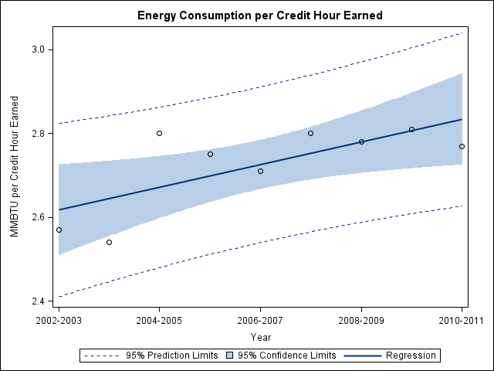
Energy and Students at NC State University

Slide 7
My
Line
Energy and Students at NC State University

Slide 8
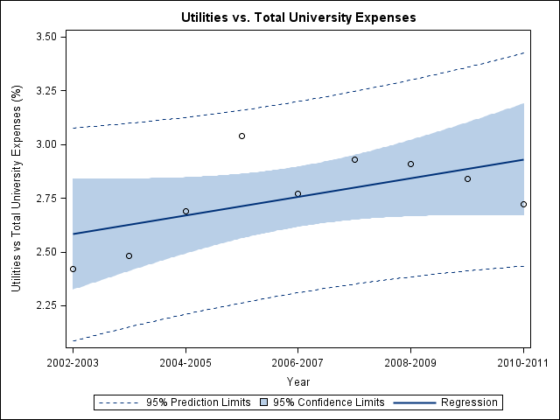
My
Line
Utility Costs as a Fraction of Total Expenses at NC State University

Slide 9
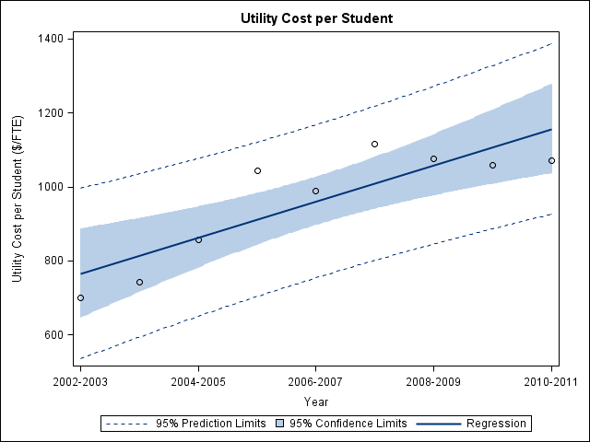
My
Lines
Utility Costs per Student at NC State University

Slide 10
Consider:
Be a leader in proper use of data
2. Use science to test hypotheses
3. Do not use science to prove your point
Carefully consider statistical needs
Consult with statistical experts
Consult with accountants and economists
7. Seek independent audits of data and financial reporting

